Slide 1

12 / 1 / 2025
COUPON RECOMMENDATIONS
Data Miners
Theresa Borlongan, Riley Coons, Yasmin Kaori Kashin Ogasawara, Talia Sandeen, Allison Schutzler​

Slide 2
PROCESS FLOW DIAGRAM
Data Preprocessing
and Exploration
Business
Problem
Modeling - XGBoost,
Neural Network
  Business Impact / Implications
Identify ML
Framework
Model Evaluation and
Improvement

Slide 3
BUSINESS UNDERSTANDING

Slide 4


BACKGROUND
​
  We are a group of data scientists that want to help a business understand whether they should send coupons to certain customers while they are driving. ​
  The dataset uses real world features to decide whether or not a coupon should be sent out.
  Features include time of day, weather, location, driver characteristics, and more.

Slide 5
WHY IT MATTERS
  Companies can develop more personalized and effective coupons by analyzing the data. ​
  Knowing which customers will use the coupons allows the business to save advertising money and generate more business. ​
  With the rise of connected cars and location-based promotions via rideshare or navigation apps, there is a lot of opportunity for this type of research.
Who Benefits?
  Shareholders can make more money.
  Customers get more relevant coupons for their shopping habits.
  The company spends less money on advertising.

Slide 6
BUSINESS PROBLEM &
ML SOLUTION
Problem
Solution
What types of customers, coupons, and driving conditions are most effective for predicting acceptance
of in-vehicle coupon promotions, and how can we utilize these insights to improve future advertising / marketing initiatives?
Conduct a binary classification problem to predict whether a coupon is accepted (Yes/No) given a set of features related to customer, driving, and coupon attributes. ​

Slide 7
DATA UNDERSTANDING
UCI Repository
Collected via survey from Amazon Mechanical Turk to observe consumer responses in different driving scenarios
Target variable: Y
⟶ if the driver accepts the coupon (1=Yes, 0=No​)
Total Instances: 12,684
Features: 25
Categorical Variables: 23
Numeric Variables: 2

Slide 8
RELEVANT VARIABLES
Driver Demographics
Coupon Characteristics
Driving Conditions
Directional
  Age​
  Gender​
  Marital Status​
  Education​
  Income​
  Coupon type​
  Expiration​
  Visitor frequency​
  Weather​
  Temperature​
  Time​
  Destination​
  Passenger
  Direction_same​
  Direction_opposite

Slide 9

POTENTIAL ISSUES
  Many categorical variables in this dataset (23) ⟶ can increase dimensionality
  Missing values for variables related to frequency and behavior
    Coffeehouse visit frequency, Bar visit frequency, etc. ​
    May lead to higher bias and restrict regression analysis​
  Potential noise from self-reported variables​
    Visit frequency, destination, passenger, etc. ​
    Reports could be inaccurate and skew the data ​

Slide 10
EXPLORATORY DATA ANALYSIS

Slide 11
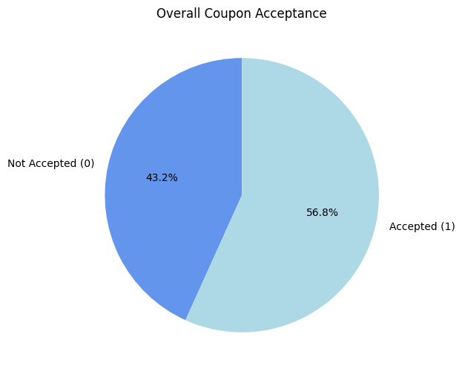
WERE MOST COUPONS ACCEPTED?
Why is this significant to our analysis?
  More customers accepted coupons than declined.
  The 43% who rejected coupons remain an important segment to target.
  The split between acceptance and rejection shows the target variable is not significantly imbalanced.

Slide 12
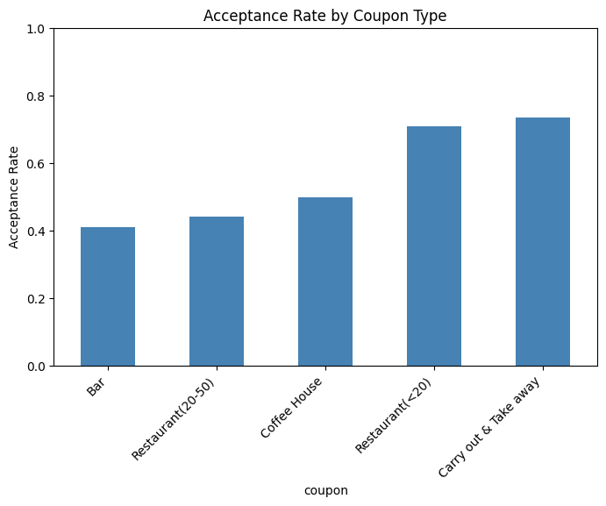
WHICH COUPONS WERE MOST ACCEPTED?
What does this mean for our analysis?
  Food-related coupons are more appealing to customers.
  Restaurant, Coffee House, and Takeaway coupons show higher acceptance rates.
  Customers are more responsive to everyday-use food incentives.

Slide 13
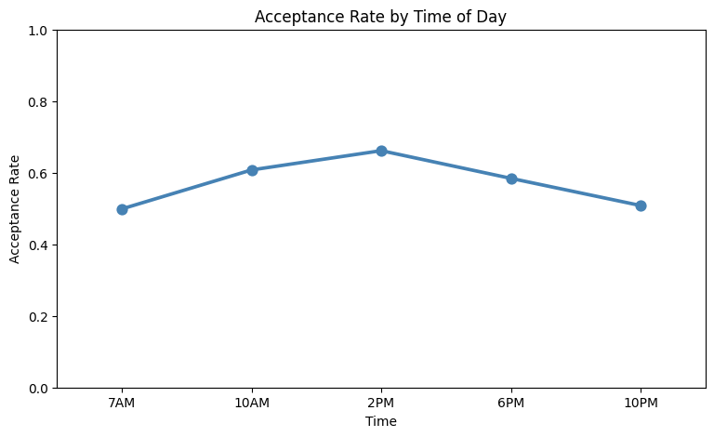
WHEN ARE CUSTOMERS MOST LIKELY TO ACCEPT?
What does this mean for our analysis?
  Time of day influences customer interest
  Acceptance increases in the afternoon and early evening
  Timing promotions correctly can boost engagement

Slide 14
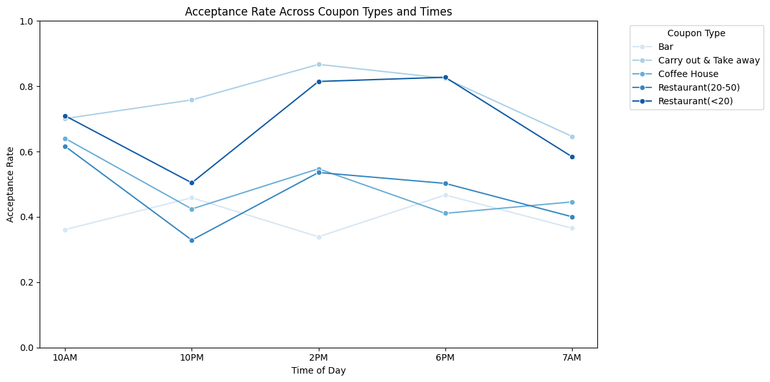
ACCEPTANCE RATE ACROSS TYPES AND TIMES
What does this mean for our analysis?
  Different coupon types peak at different times ⟶ affects performance
  Food coupons peak at lunch and early evening
  Coffee House coupons peak in the morning
  Carry-out/Takeaway performs strongly throughout the day

Slide 15
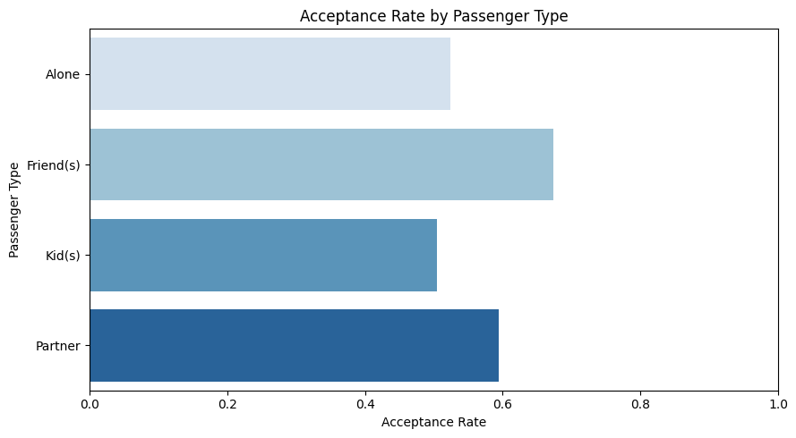
WHO ACCEPTS COUPONS MORE OFTEN?
What does this mean for our analysis?
  Social context affects decisions.
  Customers with friends accept more often.
  Those alone or with children accept less.

Slide 16
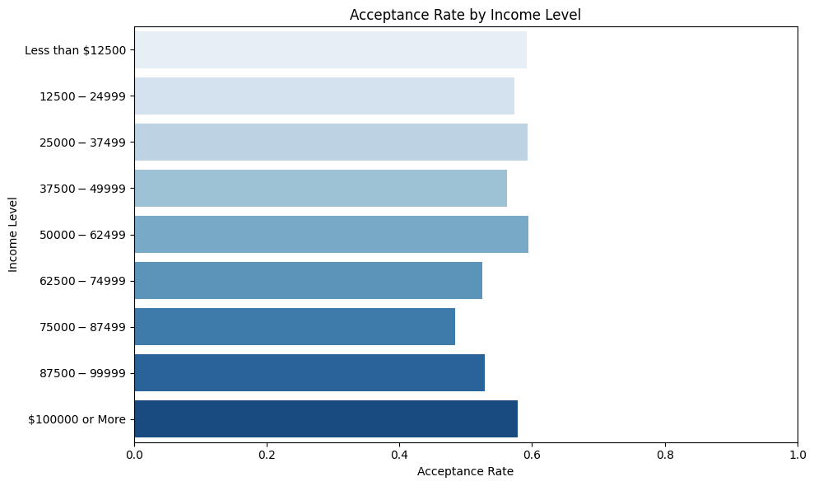
DOES INCOME INFLUENCE ACCEPTANCE?
What does this mean for our analysis?
  Lower-income customers show high acceptance rates.
  Acceptance dips among middle-income groups.
  Acceptance rises again for higher-income ranges.
  Income influences responsiveness, but not in a linear pattern.

Slide 17
DATA PREPARATION & MODELING

Slide 18
CLEANING AND PREPROCESSING
Remove duplicate rows
Convert variables to categorical type
Drop unnecessary columns
Impute missing values
Encode categorical variables
1
2
3
4
5
74 duplicated rows dropped from dataset
ex. Temperature (pre-bucketed)
  car
  direction_opp
  toCoupon_GEQ5min
  occupation
Use Simple Imputer with strategy = ‘most_frequent’
Ordinal Encoder: ordinal variables
One Hot Encoder: nominal variables

Slide 19
BINARY CLASSIFICATION
XG Boost
  Supervised machine learning
  Binary categorical target variable: Y (Yes: 1, No: 0)
  Goal: assign a given customer to one of two classes: accepted (1) or not accepted (0) a coupon
Neural Network

Slide 20
DATA SCIENCE MODELS
XG Boost
Neural Network
  Ensemble model
  Builds multiple decision trees sequentially to make highly accurate predictions
  Effective for large tabular datasets with many features
  Inspired by the human brain
  Learns complex, nonlinear patterns by passing information through multiple connected layers

Slide 21
XGBOOST

Slide 22
XGBOOST
Boosts many small decision trees to learn strong, accurate patterns
Pros:
  High performance and speed
  Reduces overfitting with built-in regularization (L1/L2)
  Performs well on tabular data like coupon acceptance
  Provides feature importance for interpretation
Cons:
  Less interpretable than single decision trees
  Complex hyperparameter tuning for the optimal model
  Can overfit even with regularization
  Computationally heavier compared to traditional models like logistic regression
What are some alternatives to XGBoost?
Random Forest
CatBoost
Support Vector Machines
Logistic Regression
Our Findings:
Frequency at restaurants and consumer convenience (i.e. distance of restaurant/bar to use coupon, carryout type coupons) were the strongest predictors of whether a coupon would be accepted.

Slide 23
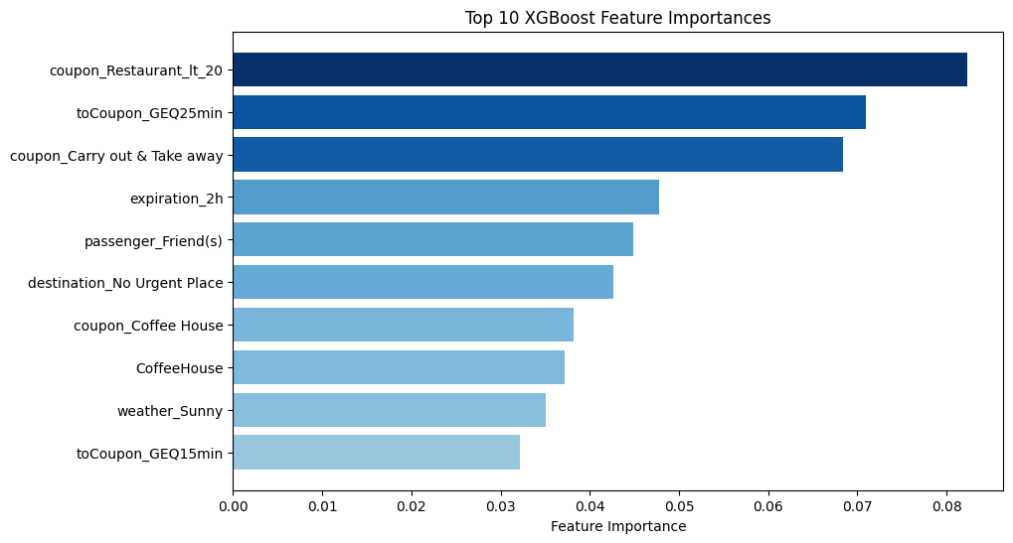

Training Set Performance
Accuracy | Precision | Recall | F1 Score
0.76 | 0.77 | 0.83 | 0.80

Slide 24
NEURAL NETWORK

Slide 25
NEURAL NETWORK
Learns complex patterns through layers of interconnected nodes
Pros:
  Captures complex, non-linear relationships
  Learns deeper patterns through hidden layers
  Adapts through backpropagation, improving accuracy
  Handles interacting behavioral variables well, useful for coupon acceptance
Cons:
  Less interpretable than tree-based models
  Sensitive to hyperparameters, needing careful tuning
  Can overfit without regularization (L2/alpha)
  More computationally heavy than simpler models like logistic regression
What are some alternatives to Neural Network?
Random Forest
XG Boost
Support Vector Machines
Logistic Regression
Our Findings:
Driver behavior, especially frequent visits to coffee shops, bars, and restaurants, along with short coupon expirations, was the strongest predictor of whether a coupon would be accepted.

Slide 26
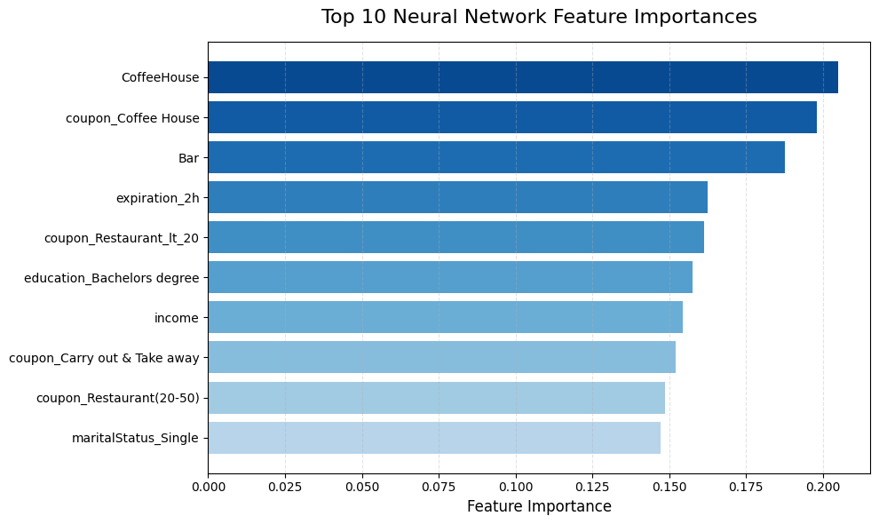
Training Set Performance
Accuracy | Precision | Recall | F1 Score
0.80 | 0.81 | 0.86 | 0.83

Slide 27
MODEL EVALUATION

Slide 28
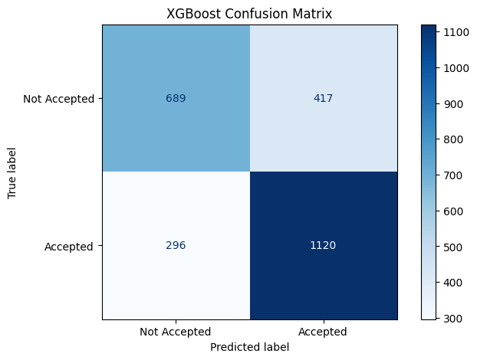
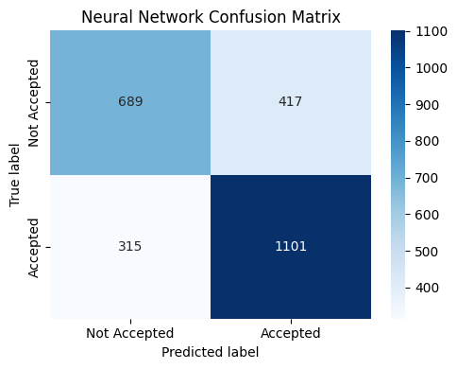
Accuracy: 72%
Accuracy: 71%

Slide 29
MODEL PERFORMANCE: TESTING
Model: | Accuracy | Precision | Recall | F1 Score
XG Boost | 0.72 | 0.73 | 0.79 | 0.76
Neural Network | 0.71 | 0.73 | 0.78 | 0.75
Results
  Both models exhibit very similar model performance
  XG Boost marginally outperforms neural network in accuracy, recall, and F1 score

Slide 30
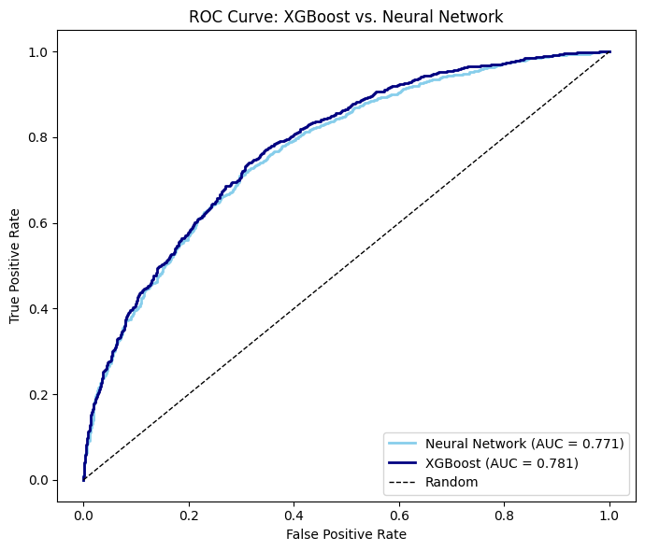
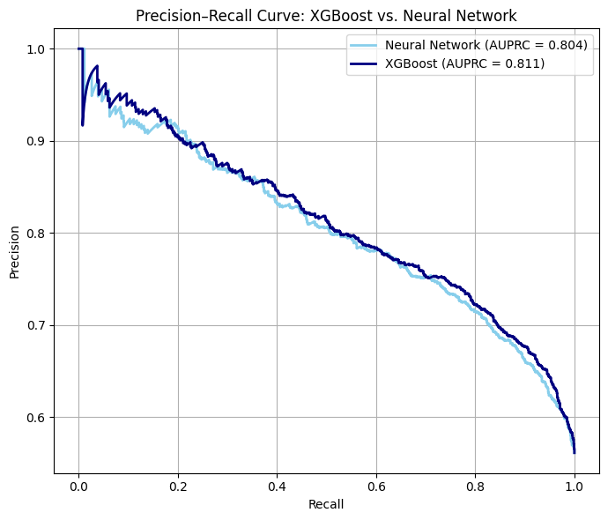
Results
  Both models still perform similarly
  XG Boost: best model overall with the highest ROC AUC and AUPRC

Slide 31
INTERPRETATION OF FINDINGS
Strong Precision
Moderate Accuracy
Behavior Insights
Stronger Model
0.811 AUPRC: Model predicts acceptance well which is ideal for targeting customers who are most likely to redeem
72% accuracy and 0.78 ROC AUC show the model reliably separates accepters from non-accepters
Both the Neural Network and XG Boost identified the same behavioral drivers (CoffeeHouse, Bar visits, coupon type)
XG Boost delivers higher accuracy, but the Neural Network adds interpretability into how behavioral patterns shape coupon acceptance

Slide 32
02
MOVING FORWARD

Slide 33
DEPLOYMENT
  Service Expansion
    Expand the model to all connected vehicles nationwide to maximize reach.
    Connect the model to other mobility apps (like navigation apps) to access more users.
  Target Expansion
    Add more coupons and retailers so drivers receive a wider range of relevant offers.
    Expand first into the busiest metro areas.
  Preventative Measures
    Use a risk score to spot when drivers might be getting too many offers.
    Set up monitoring and retraining to keep the model accurate over time.​

Slide 34

ETHICAL CONSIDERATIONS
Driver Safety and Distraction
  Prevent driver distraction at all times.
  Implement strict spatial filtering to block notifications when:
    The vehicle is in motion
    During high-complexity driving
    Near schools/hospitals.
  Notifications should be delivered only when the vehicle is stationary.
Privacy and Data Bias
  Anonymize and aggregate all location history and driving behavior data before training.
  Require opt-in consent for data usage.
  Check the model for indirect bias (e.g., driving routes that hint at income level)
  Ensure recommendations do not unfairly exclude any customer groups

Slide 35
SUMMARY
Key Findings and Model Performance
  Predictive Power: The classification models (XGBoost/Neural Network) demonstrated accuracy in identifying the optimal combination of driver profile, coupon type, and environmental factors leading to coupon acceptance.
  Feature Importance: Key drivers of acceptance include frequent visits to coffee shops, bars, and restaurants, along with short coupon expirations and distance to restaurants.
Business Impact
  Increased ROI: By moving from broad-casting to targeted promotion, the company will reduce the cost of wasted coupon distribution.
  Revenue Growth: Personalized, timely offers will increase acceptance rates, generating additional revenue.
  Customer Experience: Relevance of promotions enhances customer satisfaction and engagement.

Slide 36
NEXT STEPS
  Improving Model Performance:
    Increase regularization (e.g., alpha for NN)
    Tune model parameters (depth for XG Boost, layers for NN)
    Perform K-Fold Cross Validation
    Try additional feature engineering
  Research additional data sources
    Find non-survey data to strengthen and diversify the analysis
  Conduct market research and consider other factors in coupon acceptance
  Develop additional data science models
    CatBoost, Random Forest, Logistic Regression

Slide 37
12 / 1 / 2025
THANK YOU!
Any Questions?

